Slide 1
CARBOHYDRATES
Carbohydrates are carbon compounds that contain large quantities of hydroxyl groups. The simplest carbohydrates also contain either an aldehyde moiety (these are termed polyhydroxyaldehydes) or a ketone moiety (polyhydroxyketones). All carbohydrates can be classified as either monosaccharides,disaccharides, oligosaccharides or polysaccharides. Anywhere from two to ten monosaccharide units, linked by glycosidic bonds, make up an oligosaccharide. Polysaccharides are much larger, containing hundreds of monosaccharide units. The presence of the hydroxyl groups allows carbohydrates to interact with the aqueous environment and to participate in hydrogen bonding, both within and between chains. Derivatives of the carbohydrates can contain nitrogens, phosphates and sulfur compounds.** Carbohydrates also can combine with lipid to form glycolipids or with protein to form glycoproteins.

Slide 2
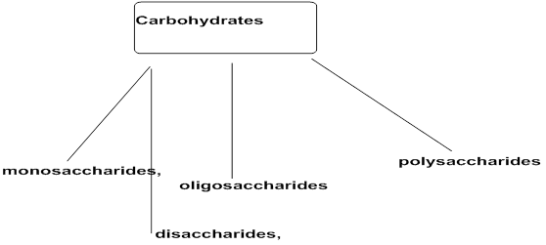

Slide 4
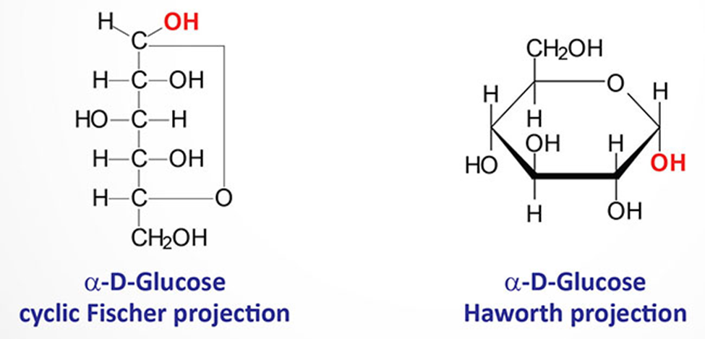

Slide 5
